Slide 1
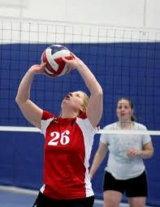
Volleyball- setting Group 3

Slide 2
When is a set used?
When the ball is over your shoulders, therefore too high to bump.

Slide 3
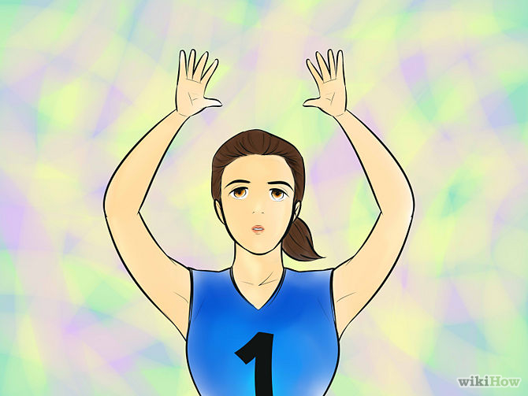
Step 1 on setting
Extend your arms over your forehead.

Slide 4
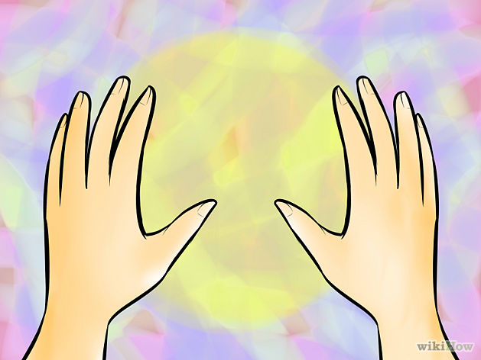
Step 2
Position your hands so that you can see them above your forehead and finish with ball shaped hands. Triangle shaped.

Slide 5
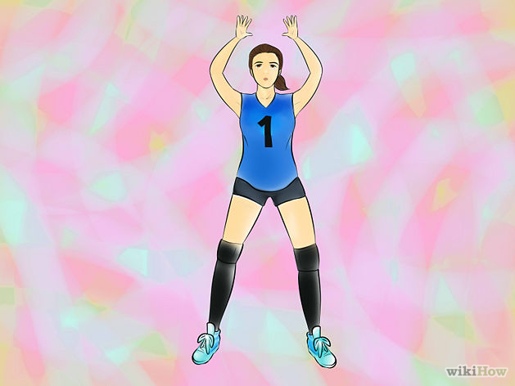
Step 3
Spread your feet about shoulder width apart your feet about shoulder width apart.

Slide 6
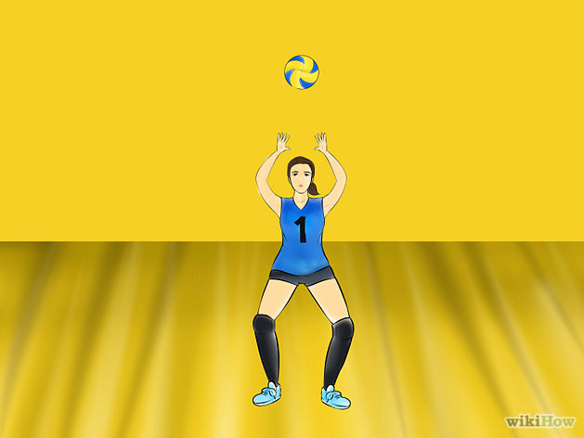
Step 4
When you are ready to set, center yourself under the ball, and push upwards, straightening your arms and legs as you go.

Slide 7
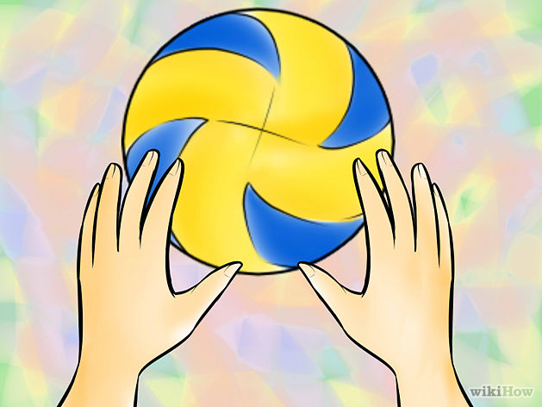
Step 5
When you set the ball get directly under it, so that it is coming right toward your forehead

Slide 8
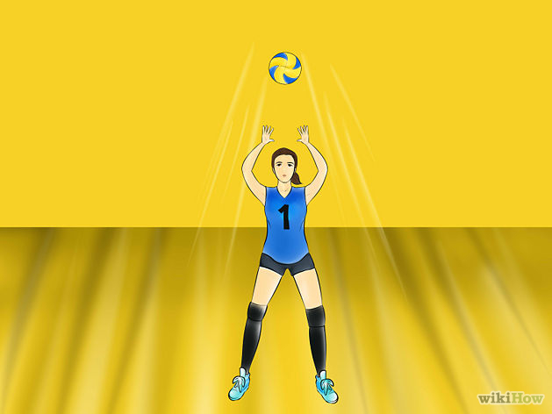
Step 6
When you bend your knees, make sure you rise up and not jump

Slide 9
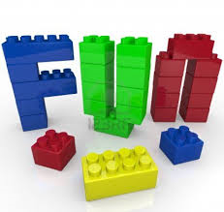
Step 7
Have fun!

Slide 10
Sites used
Google
Youtube
wikihow

